Slide 1
Business Requirement
Sales_Performance

Slide 2

Business Overview:
Project Title:
Brazillian_E_Commerce – Sales Perfromance
Business Problem
The business needs a clear view of sales performance to understand:
How much revenue is generated
When sales occur (daily/monthly trends)
Business Questions Answered
What is the total revenue?
How many orders are placed daily and monthly?
What is the average order value?
Which product categories generate the highest revenue?
Why Business Cares
Measure company growth
Identify best-selling products
Track seasonality and trends
Enable revenue and performance reporting

Slide 3
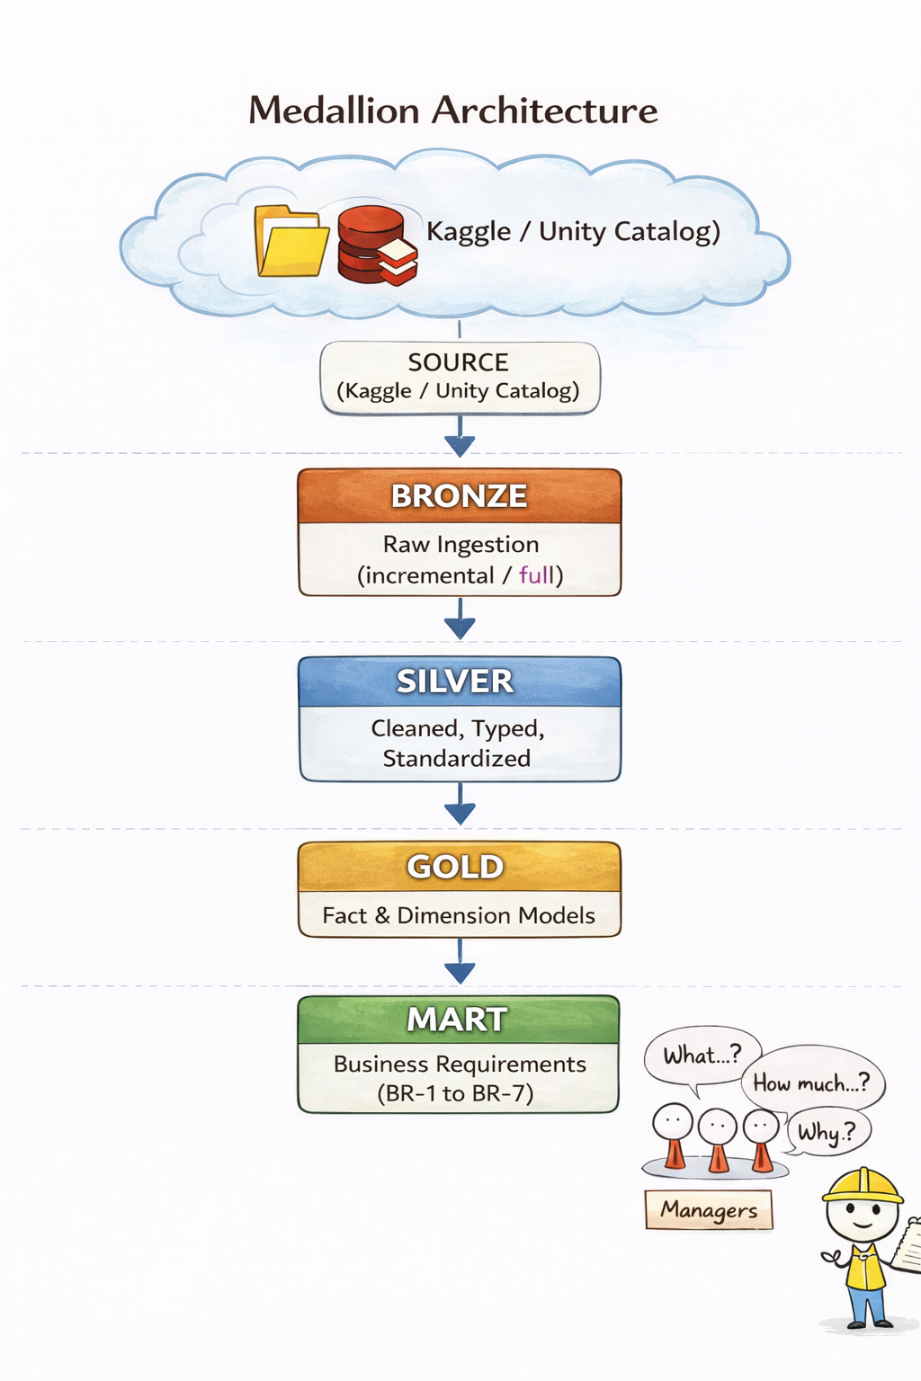
System Architecture:
End-to-End Data Engineering Architecture
Architecture Pattern Medallion Architecture (Bronze → Silver → Gold) Built on Databricks + Apache Spark

Slide 4
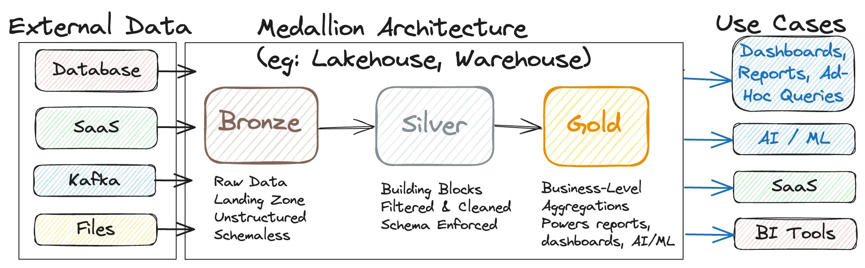
Architecture Layers:

Slide 5
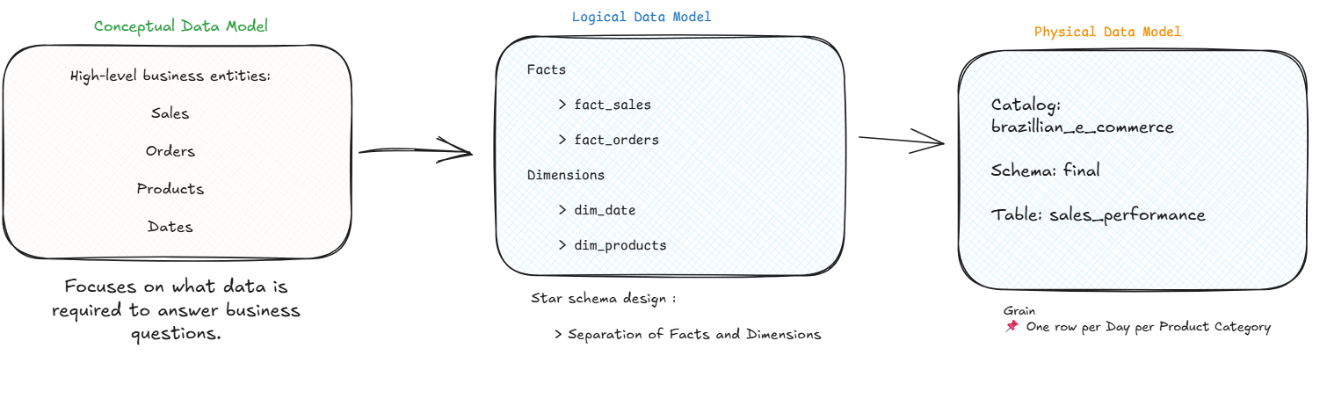
Data Model :

Slide 6

FINAL TABLE:
Sales_Performance
Table Path: brazillian_e_commerce.final.sales_performance
Key Metrics
total_revenue → SUM of sales revenue
total_orders → Count of distinct orders
avg_order_value → Revenue / Orders
Data Sources from Gold:
fact_sales
fact_orders
dim_date
dim_products

Slide 7
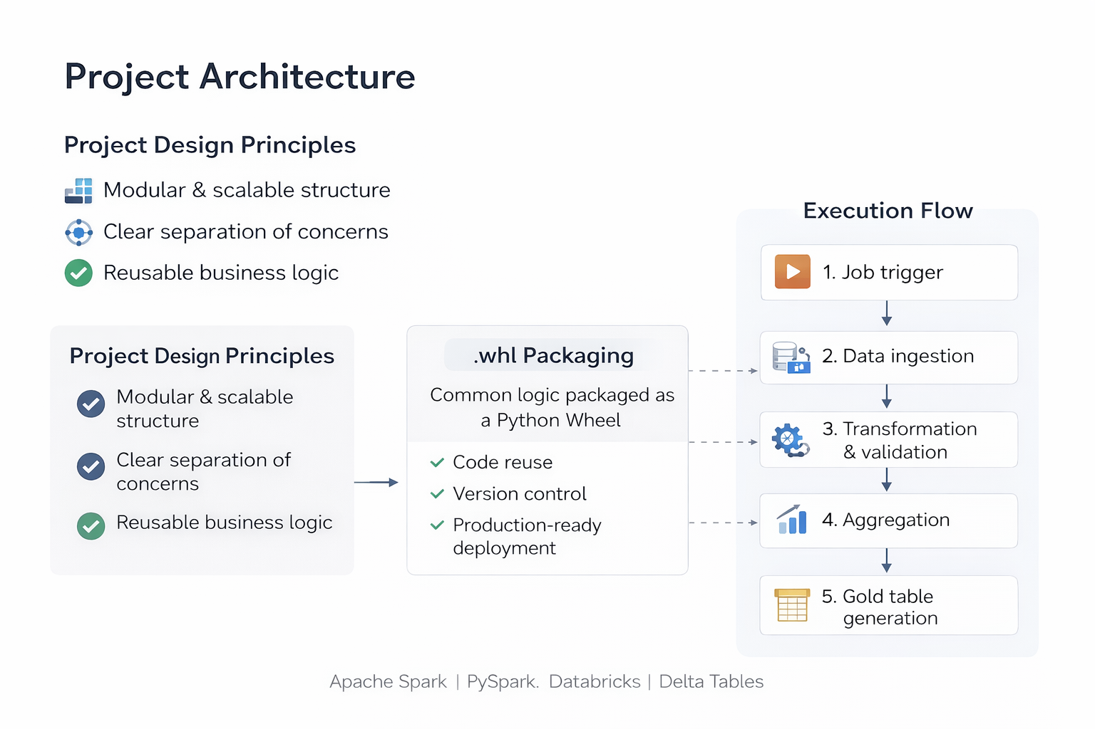

Slide 8
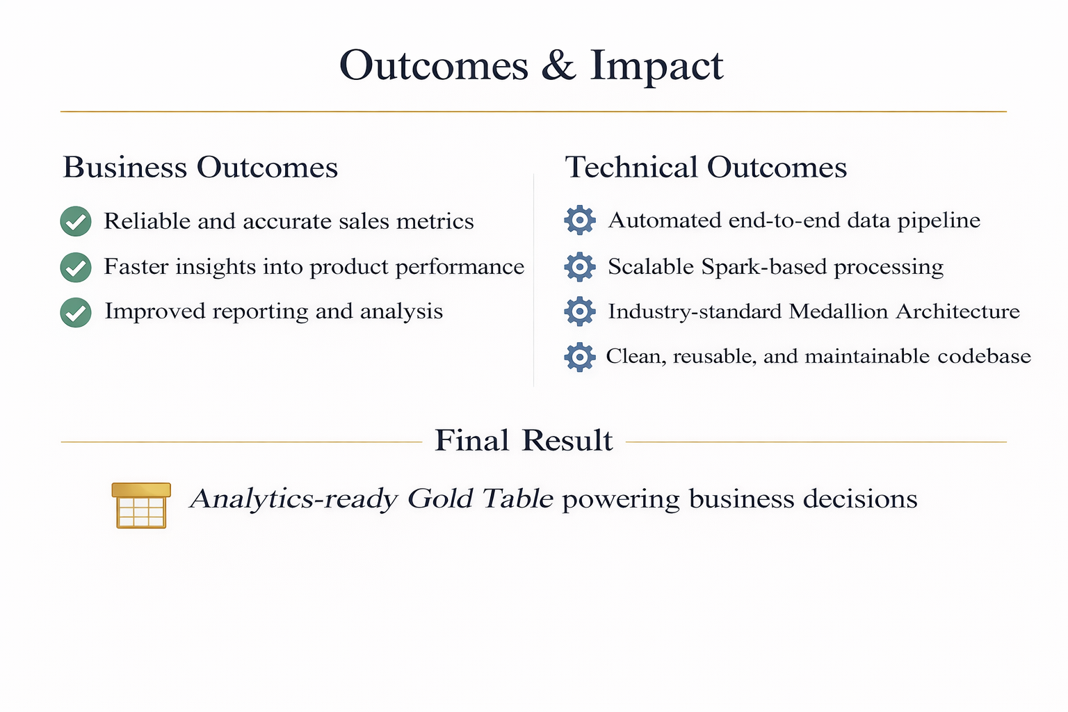

Slide 9
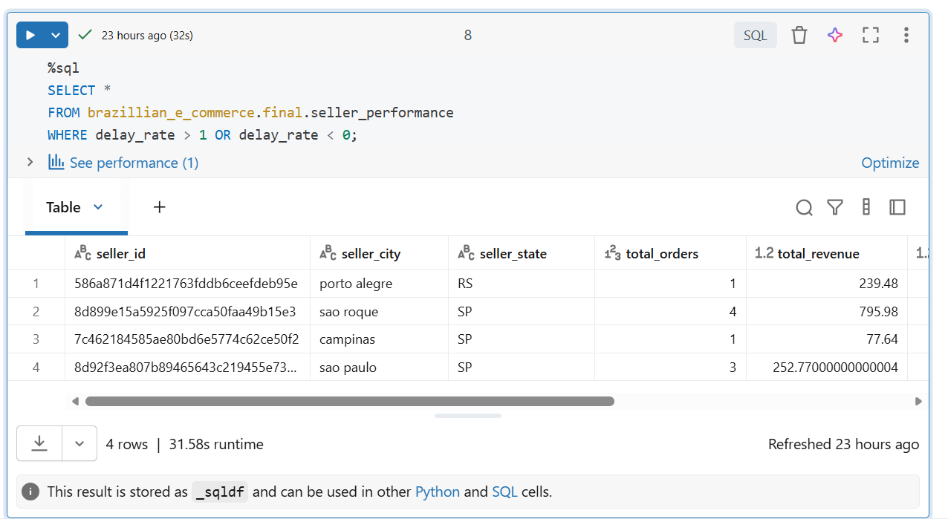
Output:

Slide 10
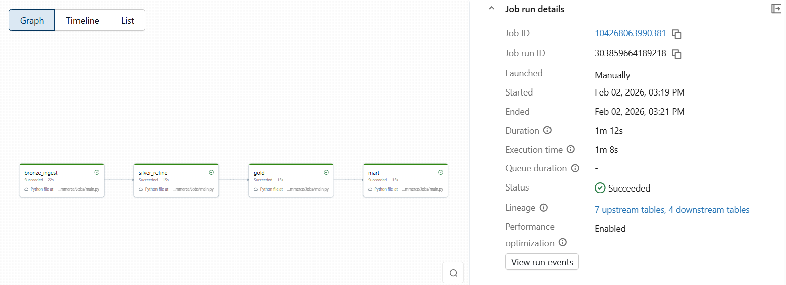
Databricks Jobs:

Slide 11
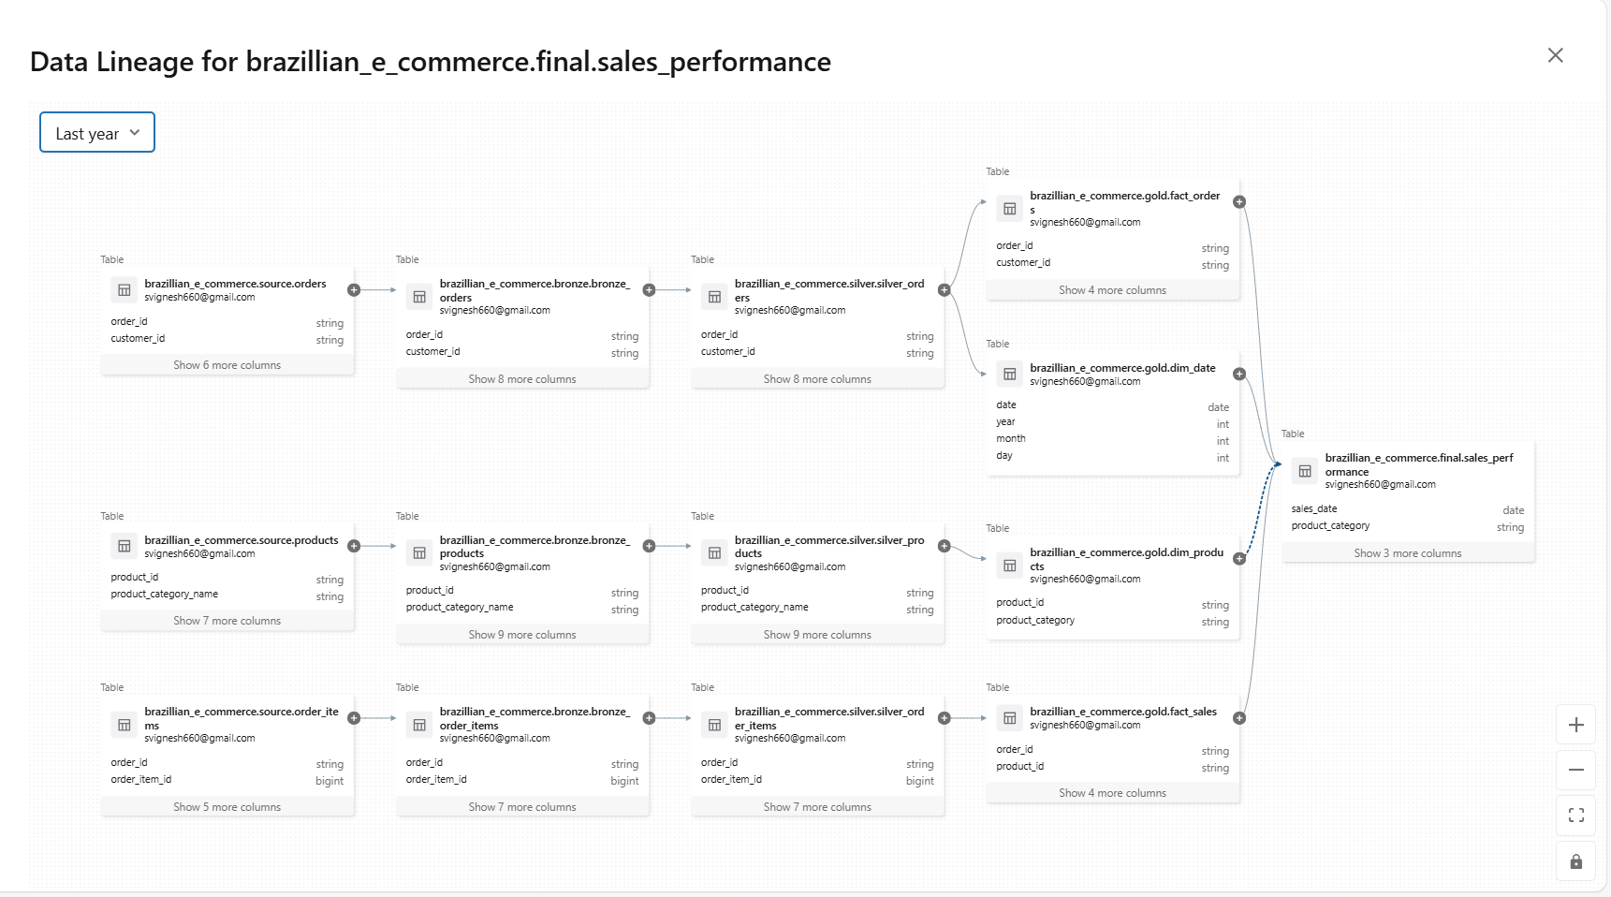
Data Lineage for Sales_Performance:

Slide 12
Thank You

